Slide 1
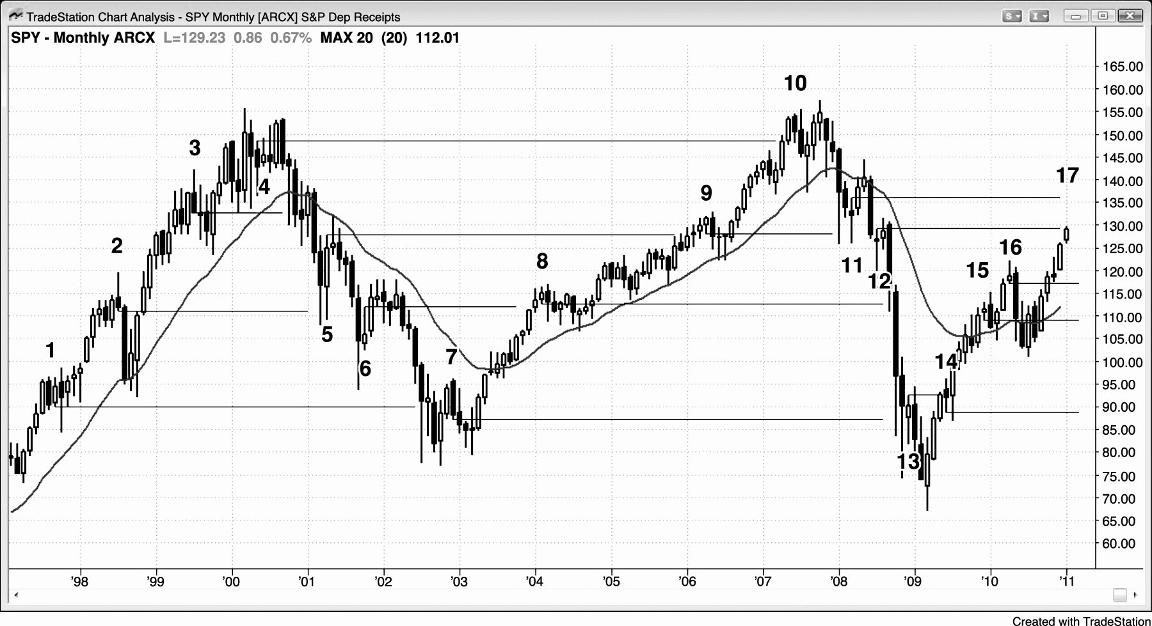
FIGURE 9.1 Earlier Entry Points Are Targets for Pullbacks

